Slide 1

Panther Creek High School Rising 10th-12th Curriculum Information

Slide 2
STUDENT SERVICES
Latrieva Wilson, A-L (9th)
Michael Smith, M-Z (9th)
Mario Jones, A-F (10th-12th)
Akanksha Jain, G-L (10th-12th)
Ashley Mathes, M-Ri (10th-12th)
Angela Spangler, Ro-Z (10th-12th)
Shernita Telfair, Dean of Students
Jasmine Iverson, SAP Counselor
Shekevia Smith-Washington, Career Development Coordinator

Slide 3

Goal of PCHS Registration Sessions
Explore the academic offerings and registration for the 25-26 school year.

Slide 4
Panther Creek Registration Information
All information will be found on the PCHS webpage
https://www.wcpss.net/Page/53437
Notes:
Link to Student Services Registration page from main PCHS webpage

Slide 5
Course Registration Timeline: General Information
February 11– 13: All students will attend registration presentations in the auditorium
  Feb. 11th - Rising 12th Grade
  Feb. 12th- Rising 11th Grade
  Feb. 13th - Rising 10th Grade

Slide 6
Course Registration Timeline – 9th-11th Grade
Week of February 14th-21st : Registration opens for current 9th - 11th graders to register for 25-26 school year; PS portal opens
Monday, February 24th - Friday, March 21st: Students will receive appointments to meet with their counselor in groups in the Media Center
The portal will close for students to self registration Friday, February 21st

Slide 7
Course Registration Timeline
February 3-14: Contact appropriate teachers regarding any course that requires an application, audition, portfolio, or recommendation (has * on the selection sheet)
Classes: Arts (Band, Chorus, Dance), Sports Medicine (III/IV), PEPI (I,II), Yearbook, Newspaper

Slide 8
Course Registration Timeline
February 24-March 21: Students will be assigned a time/date for small group meetings with counselors and counselors will review course choices entered in PowerSchool
Students will receive course verification forms that will be due to Student Services on April 14th
April 14: Last day to change course selections for 2025-2026

Slide 9
Course Registration Tips
Review the 25-26 WCPSS High School Program Planning Guide. Graduation requirements
  UNC System Admission Requirements
  Promotion Requirements
  Prerequisites/Corequisites
Review your previous courses and grades – Credit Detail Report
Talk to your teachers about possible course choices – review their recommendations
Talk to your parents
Talk to your counselor

Slide 10
Course Registration Tips
Think about what your interests are – do not choose classes based on what peers/others are doing
Think about your academic workload plus extracurricular, athletic, job, and other responsibilities
Review college/university entrance requirements for schools in which you have an interest

Slide 11
Course Registration Tips
Select 8 primary courses and 3 alternate courses for a total of 11 choices
  Include graduation requirement courses as primary choices
Be prepared to receive any combination of 8 classes from your 11 choices!
  There is no schedule change process – only a correction if there is an error.
Notes:
Emphasize any of the 11 are viable options.

Slide 12
Course Registration Resources
Use link from PCHS webpage to get to
Student Services page:
  Course Information tab:
    Course selection sheets (9th and 10th - 12th)
    CTE Pathways
  Wake Tech Community College Information
    Career and College Promise
  WCPSS High School Program Planning Guide
    Course description and prerequisite information

Slide 13
HS Core Courses

Slide 14
HS English
Grade Level | Course offerings
10th | English II Academic or Honors
11th | English III Academic, Honors or AP English Language
12th | English IV Academic, Honors or AP English Literature
4 credits required:
English I, II, III, IV

Slide 15
HS Social Studies
Grade Level | Course offerings
10th | Civic Literacy Academic/Honors or AP US Government & Politics
11th | American History Academic/Honors or AP US History
12th | Economic & Personal Finance Academic/Honors
4 credits required
World History, Civic Literacy, American History, Economic and Personal Finance

Slide 16
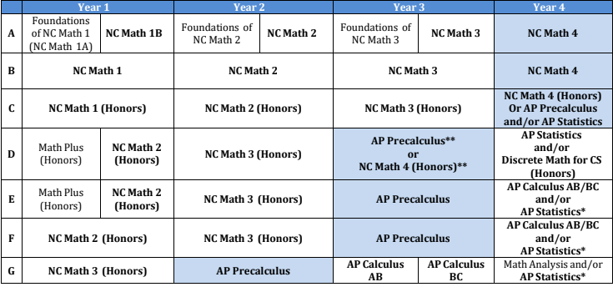
Math
4 credits required:
Math I, II, III, and a 4th math that aligns with your post secondary goals.
*Two math classes are not guaranteed in a year unless the classes are linked (AP Calculus AB/BC, FOM2/Math 2, and Math 1A/B)
*Students can sign up for any class they have the prerequisites for but should take teacher recommendations in PowerSchool into consideration
*Students should place their second Math request in the alternate spot. For ex. Math 2 & Math 3. Math 3 should be placed in the alternates

Slide 17
HS Science
9th Grade Math Course: Foundations of Math and Math IB or Math I
9th | 10th | 11th | 12th
Math 1 | Math 2 | Math 3 | Math 4
Earth Science (Honors or Acad.) | Biology (Honors or Acad.) | Chemistry/Physics/Phy. Science (Honors, Academic or AP)
3 credits
Earth Science, Biology and Lab Science (Chemistry, Physics or Physical Science)
9th Grade Math Course: Math 2 Honors (or above)
9th | 10th | 11th | 12th
Math 2 | Math 3 | Math 4 | Math Elective
Biology (Honors) | Chemistry/Physics/Phy. Science (Honors, Academic or AP) | Earth Science (Honors or AP)

Slide 18
World Languages
World language credits are NOT REQUIRED for graduation. However, they are HIGHLY RECOMMENDED for entry to a 4-year UNC system college/university.
PCHS offers Spanish and French
  Need TWO levels of ONE language
    Ex. Spanish 1&2, French 1&2
    Can still make it to the AP level if they begin sophomore year

Slide 19
Future Ready COre Course of Study
English: 4 credits
  English I, II, III, IV
Mathematics : 4 credits
  NC Math 1, Math 2, Math 3, and 4th Math option
Science: 3 credits
  Earth/Environmental Science, Biology, Chemistry/Physical Science
Social Studies: 4 credits
  World History, Civic Literacy, American History, Economics and Personal Finance
Health and PE: 1 credit
Elective: 6 credits
Total: 22 credits

Slide 20
CTE Pathways
There are several CTE Career Pathways that contain specific courses in them – these provide connection and cohesion
If you complete Prerequisite Level 1 course and the Concentrator Level 2 course, you are eligible to take the ACT WorkKeys exam as a Senior which provides career readiness credentials
  There are also supplemental employability skills classes.
  See the full list of pathways on the chart linked from the course selection sheet.

Slide 21
What about AP courses?
Advanced Placement (AP) = College level
  AP exam to earn college credit (based on university)
  One additional GPA quality point
Select AP courses for the right reasons
  Interest and strength in the academic area
  Aligns with individual and career goals
  Capable of increased academic rigor (quality of work, work ethic, attendance)
Balance course work with other responsibilities
  Extra-curricular activities, course load, work, etc.

Slide 22
More about AP courses…
View course descriptions and overviews on
www.collegeboard.org
Many AP courses have “Recommended Summer Assignments”
Students are encouraged to take the AP Exam in May
Students that may wish to DROP an AP should let us know by May 1st.
You will be required to submit an AP agreement form by April 14th
Notes:
District pays for students to take the AP exam

Slide 23
AP Course Offerings
Arts
AP Music Theory
AP Art History
AP Visual Arts (2D – Drawing or Design)
  paired with Independent Study
CTE
AP Computer Science Principles
AP Computer Science A
English
AP English Language and Composition (Juniors)
  Satisfies English III graduation requirement
AP English Literature and Composition (Seniors)
  Satisfies English IV graduation requirement

Slide 24
AP Course Offerings
Science Department
AP Biology (paired with Research Methods Honors)
AP Chemistry
  Paired with Honors Chemistry as a year-long commitment – primarily 10th grade
  Also a semester only option – for students who took Chemistry Honors
AP Environmental Science
AP Physics (I,C, Mechanics, or Electricity & Magnetism)
Math Department
AP Pre-Calculus
AP Calculus AB
AP Calculus BC
AP Statistics
Notes:
Not year-long course; curriculum is taught over the 2 courses over the year

Slide 25
AP Course Offerings
World Languages
AP French Language
AP Spanish Language (paired with Spanish V)
AP Spanish Literature
Social Studies
AP European History
AP Government & Politics (10th)
AP Human Geography
AP African American History
AP Psychology
AP United States History (11th)
  In lieu of American History– Counts as 1 graduation credit

Slide 26
Elective Courses with a Year-long Commitment
AP Biology is paired with Research Methods Honors
AP Chemistry that is paired with Chemistry Honors (students should have completed Math 3 Honors to sign up for this)
Yearbook
Newspaper (no recommendation required)
Band
Specific Dance courses
Specific Vocal Music (Chorus) courses

Slide 27
Dual Enrollment Opportunities
Wake Tech Career & College Promise (CCP)
  Is used to accelerate completion of college certificates, diplomas, and associate degrees that lead to college transfer or provide entry-level job skills
    PCHS is your primary educational institution and Wake Tech is secondary. Your Wake Tech schedule must fit around your primary schedule at PCHS.
  Available to juniors and seniors with at least a 2.8 minimum unweighted GPA; or demonstrates college readiness via an approved assessment
  Available to sophomores that are AIG for CCP Pathway courses. Non-AIG can take classes in the CTE Pathway
  Review 2025-2026 and quick steps before submitting for approval
  When you complete your CCP Application, you must also turn in a Dual enrollment form to Student Services.
    Dual Enrollment Form ≠ Principal/Designee Consent (Ms. Telfair)

Slide 28
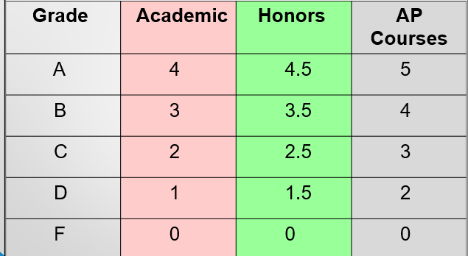
Quality points for Grade point Average (GPA)

Slide 29
Mid-Year/Early Graduation
Students can choose to graduate 1-year early or mid-year of their graduation year (January).
Students would need to inform their counselor of their intention and complete appropriate paperwork so that a graduation plan can be developed.

Slide 30
Early Release/Late Arrival
Offered to Juniors and Seniors
Reasons for LA/ER: Dual enrollment, Employment, Internship, Other (must speak with counselor prior to submitting request)
Students will sign up for 11 courses and then apply for Early Release/Late Arrival during designated timeframe
Applications will be available in April. It is best to submit the application before the end of the school year.

Slide 31
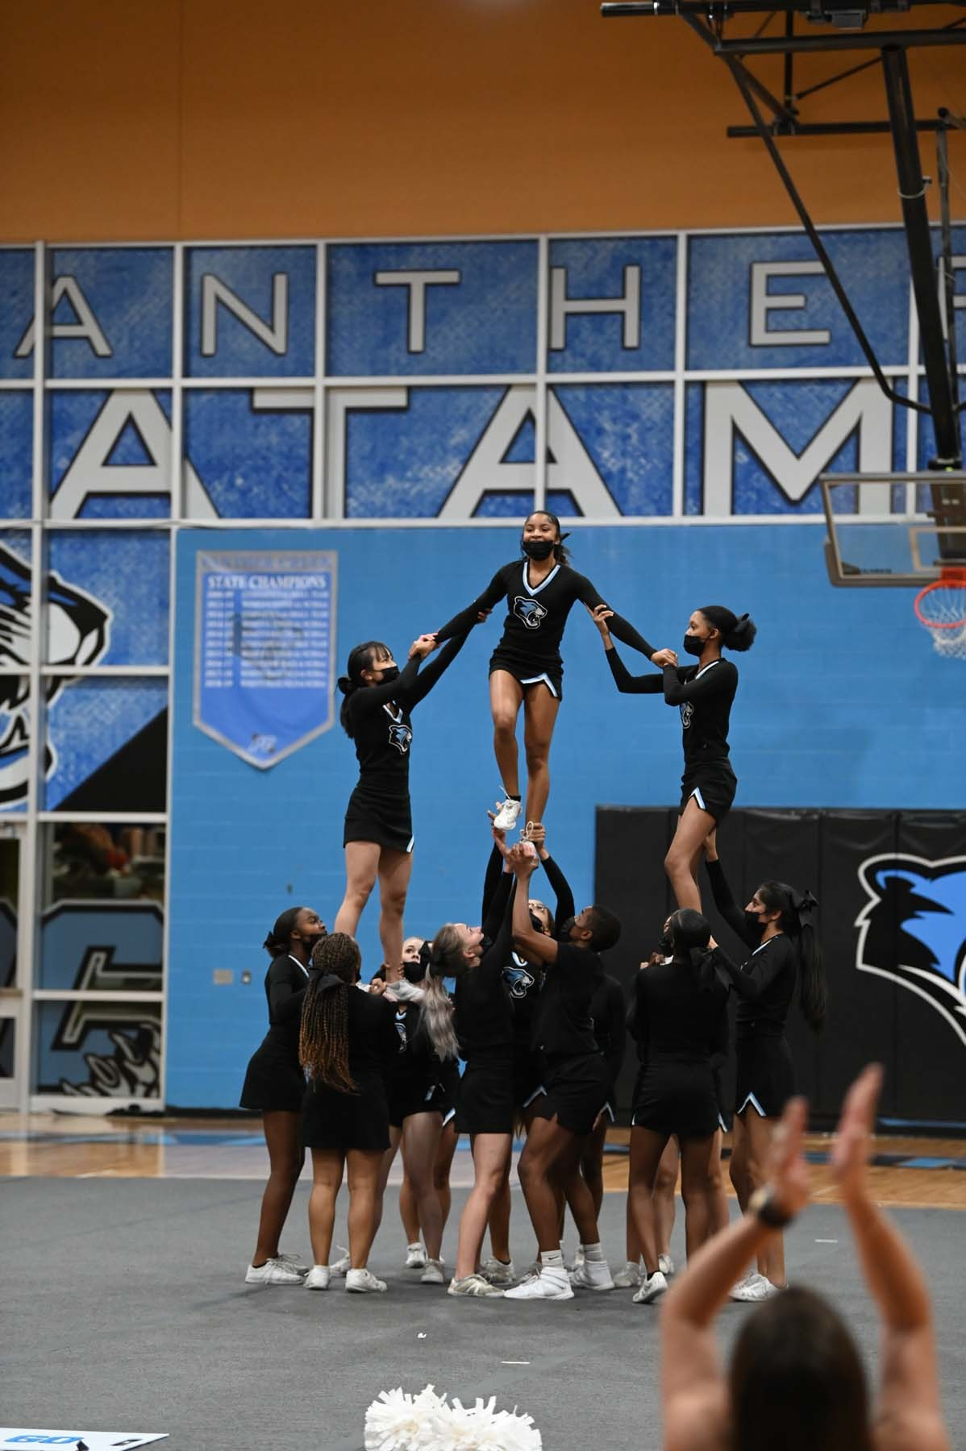
Course Registration Tips for Athletes
Students must earn three (3) credits in the semester prior to their sport season to be eligible to participate in athletics.
1.5 minimum GPA

Slide 32

The Bottom Line
Select courses wisely:
  Take courses you are interested in.
  Take a workload you can balance.
  Know that you can get any of the 11 courses combinations that you select in the registration process. We cannot guarantee your first choices.
  Talk to teachers, counselors and parents to get input.

Slide 33
Helpful Links
PCHS Rising 10th-12th Course Offerings
WCPSS 2024-25 Program Planning Guide
PowerSchool Registration Instruction (use this document to view recommendations)

Slide 34
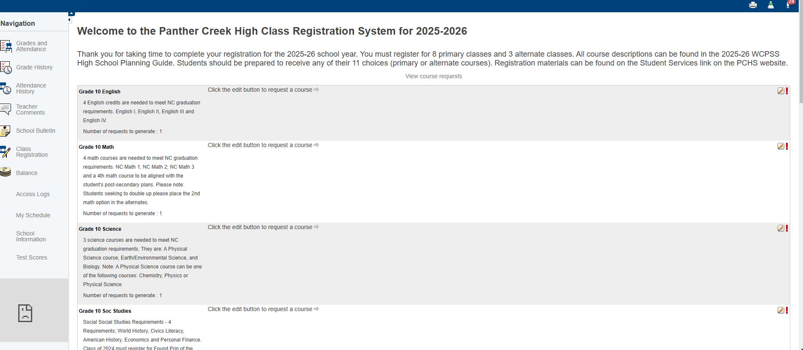
Screen Example
PCHS Rising 10th-12th Course Offerings
WCPSS 2024-25 Program Planning Guide
PowerSchool Registration Instruction (use this document to view recommendations)

Slide 35
Thank you for your attention and please let us know if you need support with the registration process!

Slide 36


